Slide 1




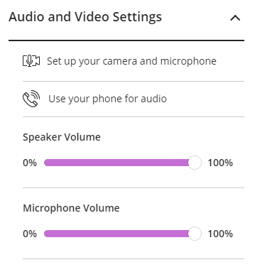

The session will begin shortly
While you’re waiting, here’s an overview of the webinar software
Webinar Options
At the bottom of the screen, you can see 4 more icons:
Sending a Message
Click on the pink Collaborate button (bottom right) to open the chat window and enter a message.
Set your status
Raise your hand
Closing the Collaborate panel
To close the Collaborate panel at any time, click on the X on the bottom right hand side.
Turn mic on and off
Turn camera on and off
Leaving the Session
Click the menu icon at the top left and then ‘Leave Session’. A recording of the webinar will be made available afterwards.
Check Your Audio
To check your audio setup, go to > My Settings - > Audio and Video Settings -> Set up Your Camera and Microphone.
Chat Window Options
Icons can be selected at the bottom of the chat window:
Chat
My Settings
To check your computer’s volume setting, go to My Settings - > Audio and Video Settings.
Here you can increase your speaker and microphone volume
Participants
Share Content

Slide 2
Academic Integrity and the Art of Referencing PG Summer School 2025 library@tcd.ie|www.tcd.ie/library|@tcdlibrary
Notes:
Slides adjusted for PG Summer School 03/06/2025 CM
(Back up copy of 'HITS Plagiarism' slides saved)

Slide 3
Welcome to Library Postgrad Summer School
Welcome to this Library training session
You don't need to speak during the session unless you want to!
We may have some participative elements where we ask you to type responses, or use your microphone/the chat box
We have included slots to answer your questions. Use the chat box, and we’ll answer during these slots, or ask it in person then with your microphone
We hope that you enjoy the session

Slide 4

Overview
Definition of plagiarism
Consequences
Detection (Turnitin)
Keeping accurate records and reference management tools
Citing/Referencing

Slide 5
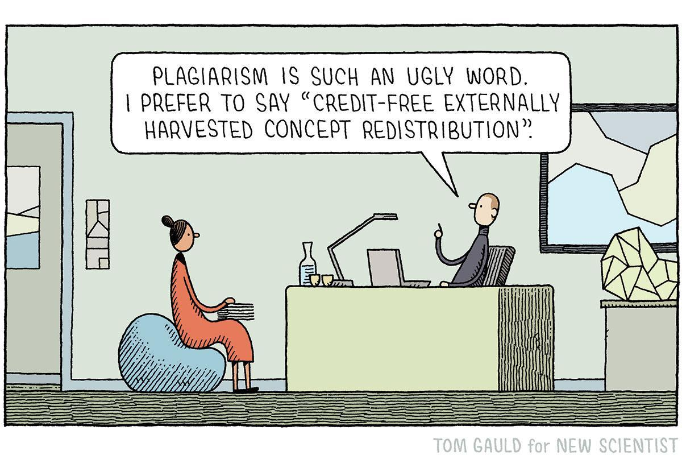
What is plagiarism?
Plagiarism is using another person’s work without giving him or her credit
If you are using somebody else’s words, images, music, or ideas you must acknowledge (cite) the original source. More on this later!
Source: https://pbs.twimg.com/media/ECVAAqJWsAED0Ko?format=jpg&name=large

Slide 6
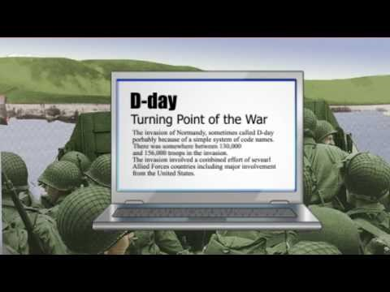
Plagiarism: a helpful summary video
Source: http://youtu.be/2q0NlWcTq1Y, Bainbridge State College

Slide 7
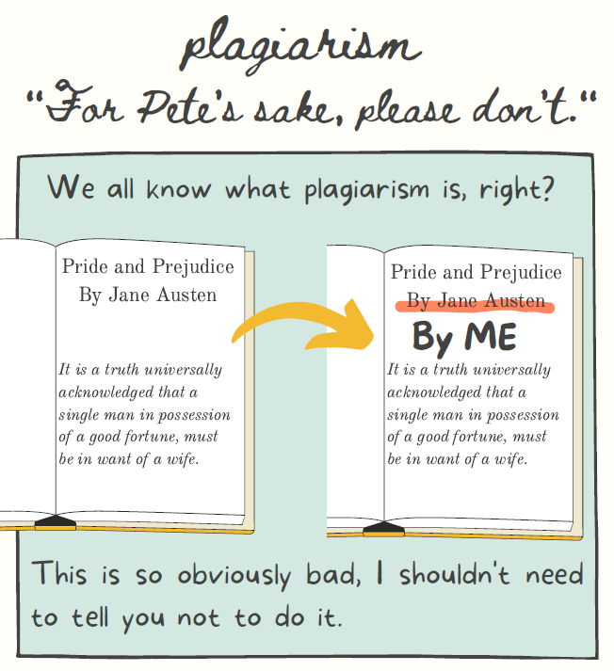
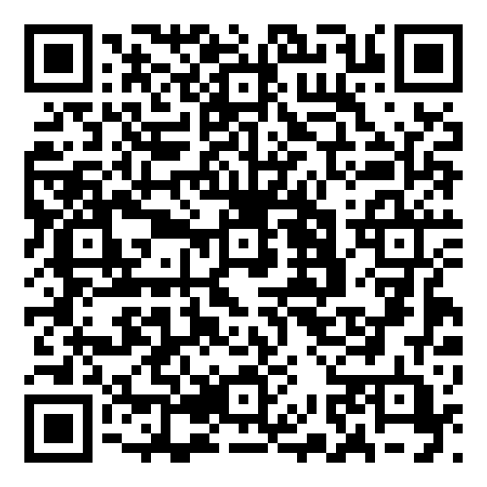
Another excellent resource
A great quick guide by Emily Myers from the University of Connecticut
Downloadable copy available from the Library website

Slide 8
It’s not just an academic thing!
Be careful if giving a speech…
Was Melania Trump's speech plagiarized from Michelle Obama?
Side by side video:
https://www.usatoday.com/videos/news/politics/elections/2016/2016/07/19/87281482/
Notes:
Reduce to two examples? Biden and Melania Trump? URLS for Word doc

Slide 9
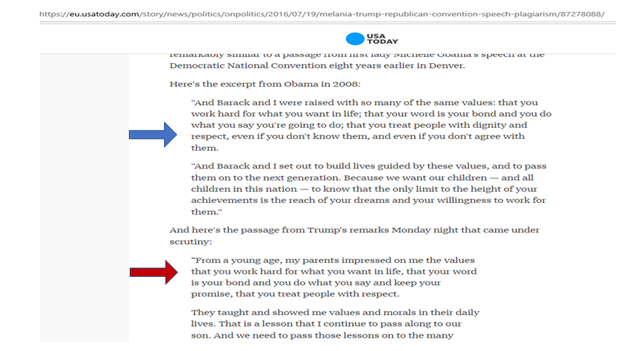
Melania Trump vs. Michelle Obama speeches

Slide 10
Consequences of plagiarism in Trinity
Detected plagiarism can carry severe consequences
It is the act of plagiarism that is punished, regardless as to whether you meant to plagiarise or not
You must complete the College’s “Ready Steady Write” plagiarism tutorial (available on the Library’s Academic Integrity website) and sign a declaration when submitting course work, whether in hard or soft copy or via Blackboard, confirming that you understand what plagiarism is and have completed the tutorial

Slide 11
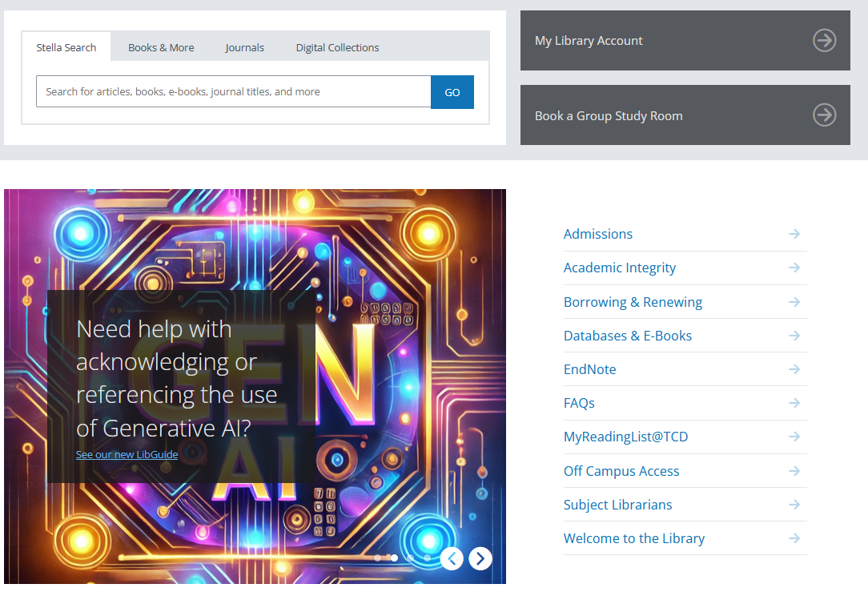
Academic Integrity – Library website
Notes:
Provide URL

Slide 12
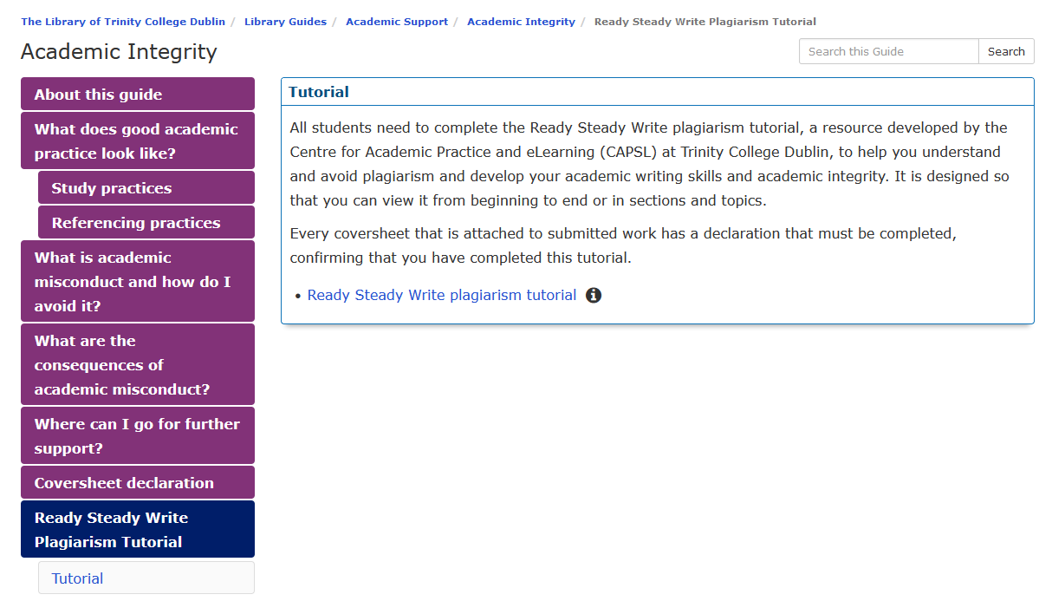
Ready, Steady, Write tutorial (available from the Library’s Academic Integrity website)
Notes:
Provide URL - All students are required to complete this tutorial.

Slide 13
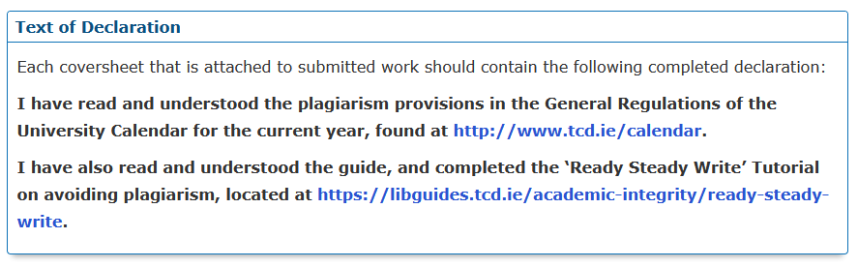
Coversheet required for each piece of submitted work

Slide 14

Detecting plagiarism
Lecturers and examiners will be familiar with key sources and will notice when information has been used from them, as well as differences in style, terminology and accuracy in an essay
In addition, the vast majority of courses in Trinity use Turnitin to check written submissions for plagiarism. This compares submitted work to a database of websites, articles, books and student papers

Slide 15
Turnitin - similarity score
The “similarity score” is not a measure of plagiarism!
You may have a high similarity score but that might be satisfactory as long as you have made sure to cite all your references
You may have a low score but you could have been heavily paraphrasing other sources without citation

Slide 16
Turnitin – Help
For help on how to use Turnitin, see Academic Practice’s advice:
https://alt-62b985ffa0afc.blackboard.com/bbcswebdav/institution/studenthelp/index.html#assignments-turnitin
(go to the Turnitin Assignments in Blackboard)
Notes:
Students should not use the Turnitin website for help as it is quite confusing for users to navigate and often gives them wrong info (e.g. they might end up looking at the advice for Turnitin.com not the Blackboard version). Also if they have issues with submitting their similarity report etc. they should contact their instructor in the first instance for help.

Slide 17
Concerns around…
Paraphrasing
Copying and Pasting
Quoting
Common knowledge

Slide 18
Paraphrasing
There is nothing wrong with including short paraphrases of others’ work (it demonstrates processing/synthesis) but you must attribute the ideas to them
Think carefully though if you decide to use a long segment of paraphrasing as you are likely to lose marks on stylistic grounds, but note this is not plagiarism as long as you have proper citations – just poor writing/style!

Slide 19
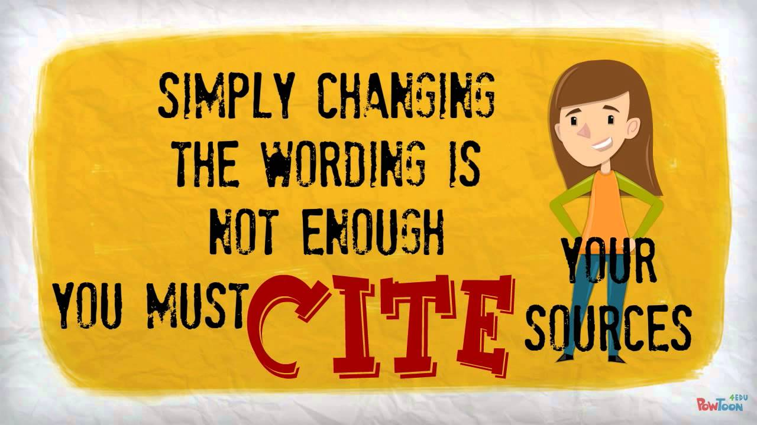
Copy, shake and paste
“Copy and paste” is *very* easy to detect, but so is “Copy, shake and paste” – mixing up paragraph order, changing words etc. to make lifted sections appear different
Source: https://www.youtube.com/watch?v=LRODESfNzcc

Slide 20
Using quotes
You will be given guidance by your department on how exactly to use quotations in your work. Any direct quotes (i.e., in a sentence) of another’s words must be put into quotation marks and attributed
Block quotes (longer quotes as a separate paragraph) should generally be used sparingly, as overuse will demonstrate you have little original material of your own to add!

Slide 21
Common knowledge? If in doubt, CITE!
Common knowledge depends on the discipline
In all academic or professional fields, experts regard some ideas as common knowledge
This is generally defined as facts, dates, events and information that are expected to be known by someone studying or working in a particular field

Slide 22
Class Discussion
You wrote an excellent essay on a topic last year. You now have to write again on the same topic for a different class for a different tutor…
Can you reuse the same essay?
If not, what do you do?
This can be a surprisingly tricky question to answer…

Slide 23
Any questions?

Slide 24
The art of referencing
We will look at:
Citing/referencing
Managing references

Slide 25
What is the point of acknowledging sources through citations?
“If I have seen further it is by standing on ye shoulders of Giants” (Newton, 1676)
Papers on the same subjects will use similar terminology, and draw on the ideas and research that has gone before. This is an expected and necessary part of research
However, it is also expected that you credit your sources by citing them
This allows readers of your work to find the original sources and see if you have adequately represented their ideas, and shows you are not trying to claim those ideas as your own
Notes:
Seán takes over at this point

Slide 26
Citation styles
Many different citation styles are in use in Trinity – your supervisor, course director or school/departmental administrator will advise if you should use any particular citation style

Slide 27
Poll: What referencing style have you been told to use?
“Harvard”
APA
Vancouver
Chicago
Irish Historical Studies
Any you like
Another
Don’t know

Slide 28
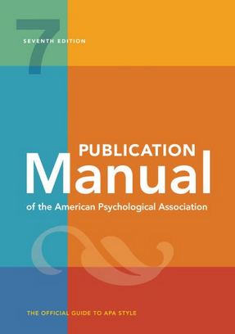

Style Guides
Eavan Boland Library
2nd Floor
LEN L492*6;1
Ussher
1st Floor
REF 808 P34*6
Notes:
Image source: easons.com

Slide 29
Citation styles
Guides for each style will tell you how to format the references:
Details on which order to present the bibliographic information
Grammar instructions such as how to use punctuation and capitalisation – e.g., what is italicised… where the full stops and commas go…
Different rules will apply to different formats of sources (journal articles, book with one author, books with several authors, edited books, chapters in edited books, webpages, reports, films, YouTube videos, e-mails, etc. etc…)

Slide 30
Citation styles
There are thousands of citation styles, but most are based on one of three broad types:
Parenthetical/Inline
Numbered
Footnotes

Slide 31

Parenthetical citations
Notes:
https://unsplash.com/s/photos/Harvard

Slide 32
Parenthetical citations
Parenthetical citations use a brief summary of the reference in the text (such as listing the author and date, or the author and title, or author and page) with the full reference stated at the end of the chapter or work
This final list is called a reference list or bibliography (generally used interchangeably, although there are technically differences)
Usually, the full list of references will be in alphabetical order by the first author’s surname
Parenthetical citations are mostly used in the sciences and social sciences, but are becoming more common in the arts and humanities
Notes:
Could we call these Parenthetical Styles and remove reference to Inline??? And say that the most common version is author-date?

Slide 33
Parenthetical citations
Parenthetical styles are sometimes called the “Harvard” style as they were first used at Harvard in the 1880s
They are called “Parenthetical” styles as they enclose the partial information in brackets
They are also sometimes called “Inline” styles
Most use author and date and so those styles are often referred to as Author-Date styles
Not all use author-date, e.g, MLA uses author and page number

Slide 34
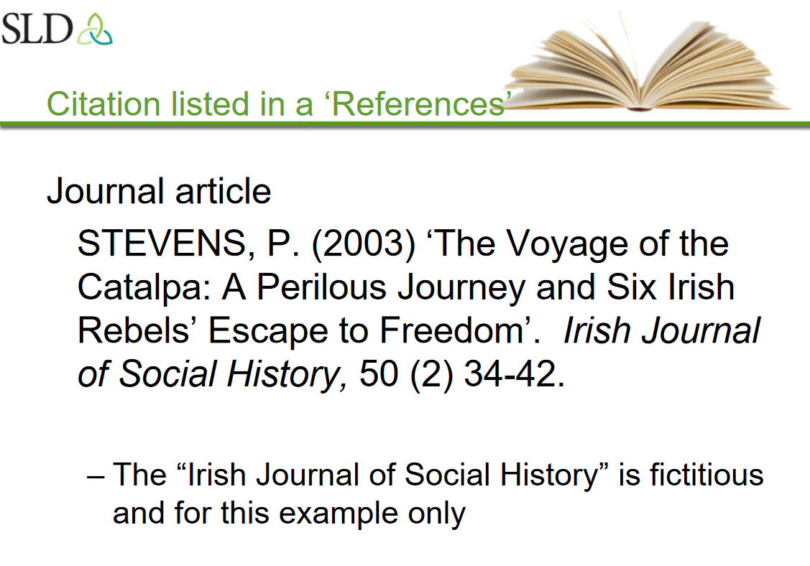
Citation Style Example SLD

Slide 35
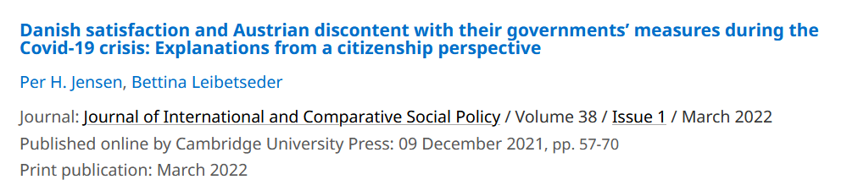
QUIZ: How do you cite this article?
Danish satisfaction and Austrian discontent with their governments’ measures during the Covid-19 crisis: Explanations from a citizenship perspective
Jensen, P.H. and Leibetseder, B.
Journal of International and Comparative Social Policy
2022
38
1
57–70
doi:10.1017/ics.2021.14.

Slide 36
Option 1.
JENSEN, P. H. & LEIBETSEDER, B. 2022. Danish satisfaction and Austrian discontent with their governments’ measures during the Covid-19 crisis: Explanations from a citizenship perspective. Journal of International and Comparative Social Policy, (38), 1 57-70. https://doi.org/10.1017/ics.2021.14
Option 2.
P. H. , JENSEN, & B. LEIBETSEDER . ‘Danish satisfaction and Austrian discontent with their governments’ measures during the Covid-19 crisis: Explanations from a citizenship perspective’. Journal of International and Comparative Social Policy, pp. 57-70, 2022. https://doi.org/10.1017/ics.2021.14
Option 3.
JENSEN, P. H. & LEIBETSEDER, B. (2022). ‘Danish satisfaction and Austrian discontent with their governments’ measures during the Covid-19 crisis: Explanations from a citizenship perspective’. Journal of International and Comparative Social Policy, 38 (1) 57-70. https://doi.org/10.1017/ics.2021.14
How would you reference this article, 1, 2 or 3?

Slide 37
Correct : Option 3
JENSEN, P. H. & LEIBETSEDER, B. (2022). ‘Danish satisfaction and Austrian discontent with their governments’ measures during the Covid-19 crisis: Explanations from a citizenship perspective’. Journal of International and Comparative Social Policy, 38 (1) 57-70. https://doi.org/10.1017/ics.2021.14
Author’s last name, Author’s first initial. (Year in brackets) ‘Title of article in quotation marks. Title of Journal in Italics, Volume number (issue number in brackets) page - numbers. https://doi.org/addlinkfore-journal

Slide 38
Option 1.
JENSEN, P. H. & LEIBETSEDER, B. 2022. Danish satisfaction and Austrian discontent with their governments’ measures during the Covid-19 crisis: Explanations from a citizenship perspective. Journal of International and Comparative Social Policy, (38), 1 57-70.
Option 2.
P. H. , JENSEN, & B. LEIBETSEDER . ‘Danish satisfaction and Austrian discontent with their governments’ measures during the Covid-19 crisis: Explanations from a citizenship perspective’. Journal of International and Comparative Social Policy, (38), 1 pp. 57-70, (2022)

Slide 39
Our Example
Reference Type: Journal Article
Author: McClimens, Alex; Kenyon, Lynn; and Cheung, Heidi
Year: 2013
Title: Exploring placement pathways in nurse education
Journal: British Journal of Nursing
Volume: 22
Issue: 1
Pages: 8-15
DOI: 10.12968/bjon.2013.22.1.8

Slide 40
Parenthetical style – APA 7th ed.
In the text:
…it’s clear that integrated care places new demands on students (McClimens et al., 2013)
Reference list:
McClimens, A., Kenyon, L., & Cheung, H. (2013). Exploring placement pathways in nurse education. British Journal of Nursing, 22(1), 8-12, 14-15. https://doi.org/10.12968/bjon.2013.22.1.8

Slide 41
Numbered styles
Numbered styles list references in the order they are mentioned, using a digit in the text to refer to the fuller citation at the end
The most common numbered style is Vancouver - while this style has its own particular rules, numbered styles in general are often referred to as Vancouver styles
Other common styles used are IEEE, JAMA, and the Lancet

Slide 42
Numbered style – Vancouver
In the text:
…it’s clear that integrated care places new demands on students (1).
Reference list:
1. McClimens A, Kenyon L, Cheung H. Exploring placement pathways in nurse education. British Journal of Nursing. 2013;22(1):8-15.
Numbers are reused for the same reference!

Slide 43
footnoting styles
Like numbered styles, footnoting styles give the reference an ascending number in the text and the full references are listed in that order at the bottom of the page in a footnote. A full list at the end of the work or chapter may also be required - although unlike with numbered styles, this will be in alphabetical order by surname, rather than in order of mention
The Chicago 17th Edition “Notes and Bibliography” style is the latest version of the best-known footnoting style
Another (used by the School of History here) is the Irish Historical Studies style
Notes:
Could we simplify slightly? And possibly omit reference to IHS?

Slide 44
Footnote style – Chicago Footnote 17th ed.
In the text:
…it’s clear that integrated care places new demands on students¹
As a footnote at the bottom of the page:
¹ Alex McClimens, Lynn Kenyon, and Heidi Cheung, "Exploring Placement Pathways in Nurse Education," British Journal of Nursing 22, no. 1 (2013), https://doi.org/10.12968/bjon.2013.22.1.8.
(elements are separated by commas)
In the reference list, which is in alphabetical order:
McClimens, Alex, Lynn Kenyon, and Heidi Cheung. "Exploring Placement Pathways in Nurse Education." British Journal of Nursing 22, no. 1 (2013): 8-15. https://doi.org/10.12968/bjon.2013.22.1.8.
(first author’s name inverted, elements are separated by full stops)

Slide 45
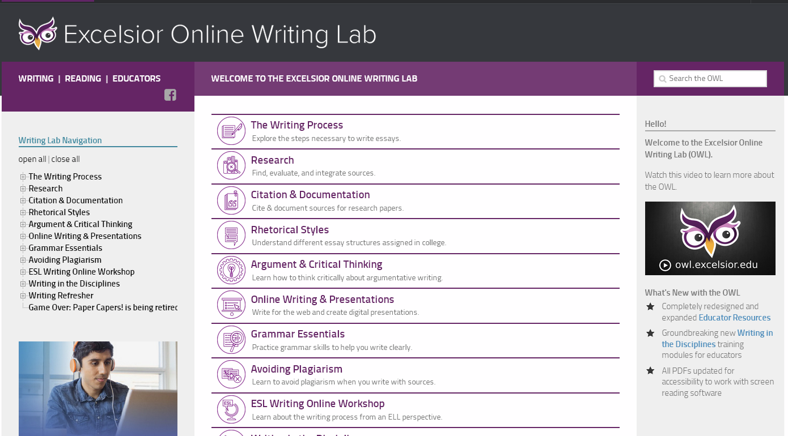
Excelsior Online Writing Lab: A great resource for style guides
https://owl.excelsior.edu/
Notes:
Provide URL

Slide 46
Maintaining accurate records
It is vital to maintain accurate records of your sources, in order to be able to properly attribute the phrasing and ideas you draw from them
There are different approaches to keeping accurate records, e.g., you might keep full handwritten or word-processed notes detailing each reference
Another way would be to save particular searches or records (e.g., by marking those records) in individual databases, e.g., JSTOR or PubMed
Stella will allow you to mark records in a similar way and save or e-mail the results to your computer

Slide 47
Reference management tools
The easiest way to bring together references from all sources is to use bibliographic/reference management tools
These tools allow you to import records from multiple databases, library catalogues, to manually enter citations, and save all your references in one location
They also allow you to grab these records and insert them into documents on which you are working

Slide 48
Have you used any reference management tools before?
EndNote
Zotero
Mendeley
Word’s built-in referencing
Another
None

Slide 49
Reference management tools
Commonly used tools include: Zotero, EndNote Online, EndNote Desktop and Mendeley
EndNote Online is free for all members of Trinity to use. It is cloud-based, with a small plugin to install on your computer that enables it to be used with Microsoft Word
EndNote Desktop is an app installed on a particular computer – it is also free for all members of Trinity to use and can be downloaded from the Library website. Many researchers find it more powerful than EndNote Online but some use EndNote Desktop and EndNote Online together
The Library provides support for both EndNote Desktop and EndNote Online

Slide 50
But I need more info about…
General plagiarism questions -
start at https://libguides.tcd.ie/academic-integrity and complete the tutorial
e-mail your Subject Librarian
General referencing questions –
try Excelsior Online Writing Lab – a great resource for style guides
e-mail your Subject Librarian
Turnitin – talk to your supervisor, course director or school/departmental administrator first
Which referencing style to use – talk to your supervisor, course director or school/departmental administrator
EndNote – us again (Library Subject Librarian team)
Academic writing in general – Student Learning Development
Notes:
Simplify and update? Eg no duty desk???

Slide 51
Any questions?

Slide 52
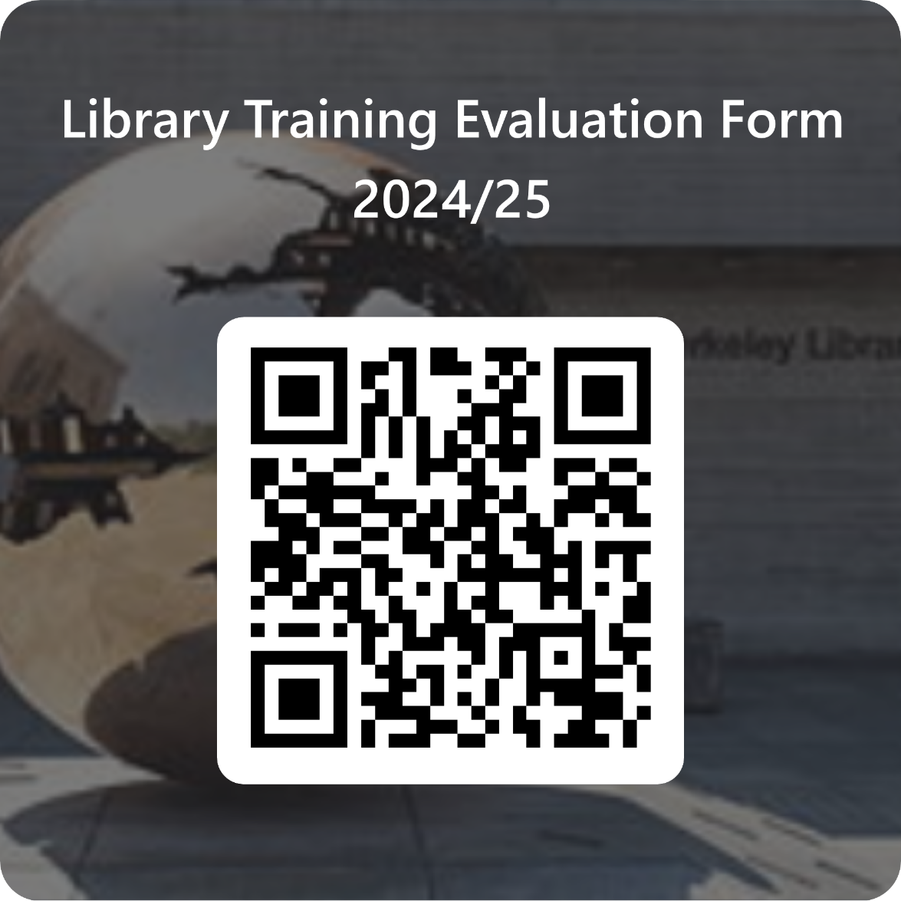
Please scan to complete our feedback form
​

Slide 53
Thank You
Feel free to contact us with any queries:
library@tcd.ie
www.tcd.ie/library
@tcdlibrary

