Slide 1
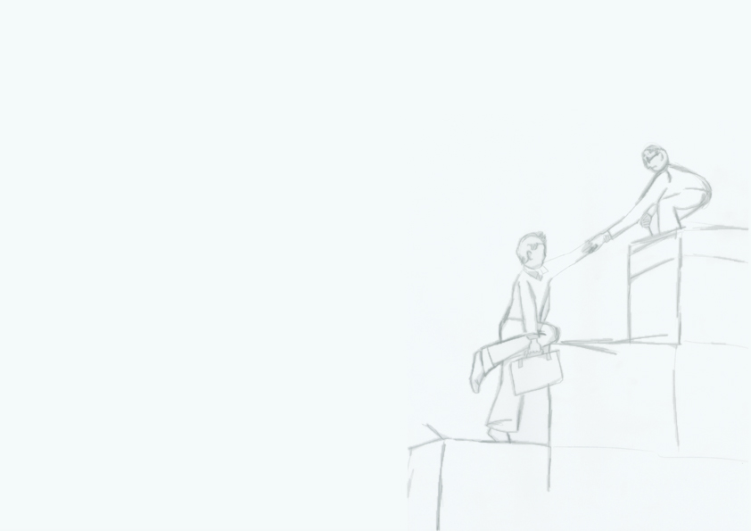


The Supervisor-Student Relationship
Postgraduate Advisory Service
Martin McAndrew (he/him)
postgrad.support@tcd.ie
@TCDPGAdvisory
#TCDPostgrads
Notes:
Martin

Slide 2

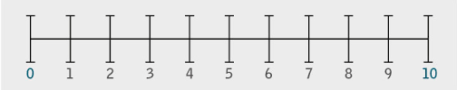

What’s different about supervision?
What are the common concerns around supervision?
Is there a power imbalance in the supervision relationship?
Notes:
Nonie + Martin (supervisor perspective)

Slide 3
What’s different about supervision?
Guide not a travel companion
Not an expert in your topic:
You Are!
Academic & Professional Relationship
NOT
Pastoral & Personal
Notes:
Martin (blue) + Nonie (orange)
Your supervisor is primarily concerned with your research and your work. There are lots of supports in College for personal & pastoral issues, which are there to scaffold you e.g. SLD, Counselling, PAS. Supervisors aren’t counsellors but it is a good idea to let them know if anything will impact on the delivery of your work

Slide 4
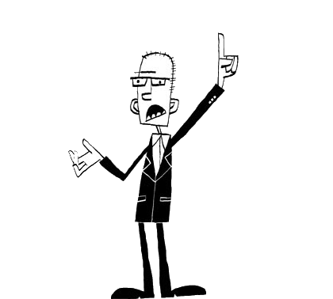
Let’s build the ideal supervisor
Provides constructive feedback
Patient
Good communicator
Available
Friendly
Knowledgeable
Notes:
Nonie: if we were building the ideal supervisor from the ground up, what would the ideal characteristics be? Turn to person next to you
Now in groups / pairs, you have the chance to build (like Dr. Frankenstein) your ideal supervisor.
What qualities would he or she have?
How would they come across?
Nonie elicit feedback
Martin records feedback

Slide 5
Supervisor’s Responsibilities
Below is what Trinity expects of supervisors:
Guidance throughout
Advice on quality
Regular communication
Regular meetings
Sabbatical replacement
Constructive Feedback
Guidance on structure
Guidance on writing
Final reading
Notes:
Martin
5.4 Responsibilities of the Supervisor (adapted from University of Exeter guidelines [1.6.4])
The essential responsibilities of the supervisor are listed below – a number of these responsibilities appear in the section on the ongoing process of supervision.
5.4.1 To give guidance about the nature of research and the standard expected. This includes guidance on planning of the research, research methods and techniques, direction to relevant literature and sources and information about relevant training programmes on offer.
5.4.2 To ensure the candidate is aware of regulations and legal issues including, but not limited to data protection, copyright, intellectual property and ethical considerations.
5.4.3 To assist in the arrangement of necessary administrative steps such as approval of thesis title, registration, and transfer to the PhD register.
5.4.4 To establish and maintain regular contact through meetings held at a frequency commensurate with the nature, stage, and level of research being
undertaken. The frequency of such meetings is to be determined by the Department but should not be less than once per month.
5.4.5 To request written work as appropriate and return such work with constructive feedback within an agreed period of time.
5.4.6 To provide guidance and assistance to the candidate regarding presentation or publication of the research both internally and externally.
5.4.7 If necessary, to warn the student, in writing, of inadequate progress or of any unsatisfactory standard of work.
5.4.8 To provide guidance on the writing and preparation of the thesis. This should include commenting on at least one draft.
5.4.9 To ensure that the student is prepared for the viva and understands its role in the overall examination process.
5.4.10 To advise the student subsequently of the implications of any recommendations from the examiners and assist in the preparation of any re-submission.
5.4.11 To encourage independent thought and investigation, and to ensure the student is clearly aware of the requirements, and appreciates what they are expected to achieve, in the course of their degree.
5.4.12 To assist the student after the completion of the research degree, in providing references or direction to postdoctoral opportunities.

Slide 6

Are you the ideal student?
Meets Deadlines
Hard-working
Knowledgeable
Conscientious
Innovative
Good communicator
Independent
Notes:
Nonie. Let’s turn inwards. What are the characteristics of the ideal student? Now in groups / pairs again, thinking from a supervisor’s perspective, build the ideal student
What qualities would he or she have?
How would they come across?
Nonie elicit feedback
Martin records feedback

Slide 7

Your Responsibilities
You take full responsibility for work submitted
Undertake training as agreed
Produce written work as agreed
Ensure compliance with regulations/ethical requirements
Stay in regular communication
Come prepared to meetings
Manage time effectively
Seek support early
Notes:
Nonie – this slide lists what the University says are formally your responsibilities
Trinity is unique in that you take full responsibility for your work submitted – you don’t need your supervisor’s permission to submit
Seek support early – don’t ignore and hope it goes away
Student role ‘LimboLand’ – falls between undergrad student and staff member.
which set out, among other things, the very minimum level of supervision that supervisors should provide for their research postgraduates. This includes the supervisor being required to request regular written work and to return the work with constructive criticism. Importantly, these documents also set out the responsibilities of the research student themselves.
Copy of the guidelines
(Calendar part II) 12 – 18 months

Slide 8
But…
These are the high-level guidelines
Structure and quality of supervision varies
So…
How do you ensure that you get the most from your Supervisor?
What do you do if things aren’t going to plan?
Notes:
Martin

Slide 9

Empower yourself
Notes:
Nonie: We’ll now cover some practical things you can do to ensure you get the most out of the supervision process

Slide 10
Change your perspective
Supervisor as a hired consultant:
Paid to guide you and answer your queries
Use their expertise
Make the most of their time
Ask the right questions!
The supervisor is not the expert on your topic!
Notes:
Martin - A shift in mindset – think of your supervisor as a hired consultant
Use them intelligently: be prepared with questions/ help you can’t get elsewhere.

Slide 11

Be Proactive
Find out what to expect from them (different styles)
Find out what is expected of you
Organise and agree process, timelines, diaries
Tackle concerns early on
Take the initiative
Notes:
Martin: find out what is expected
take the initiative in raising problems or difficulties

Slide 12
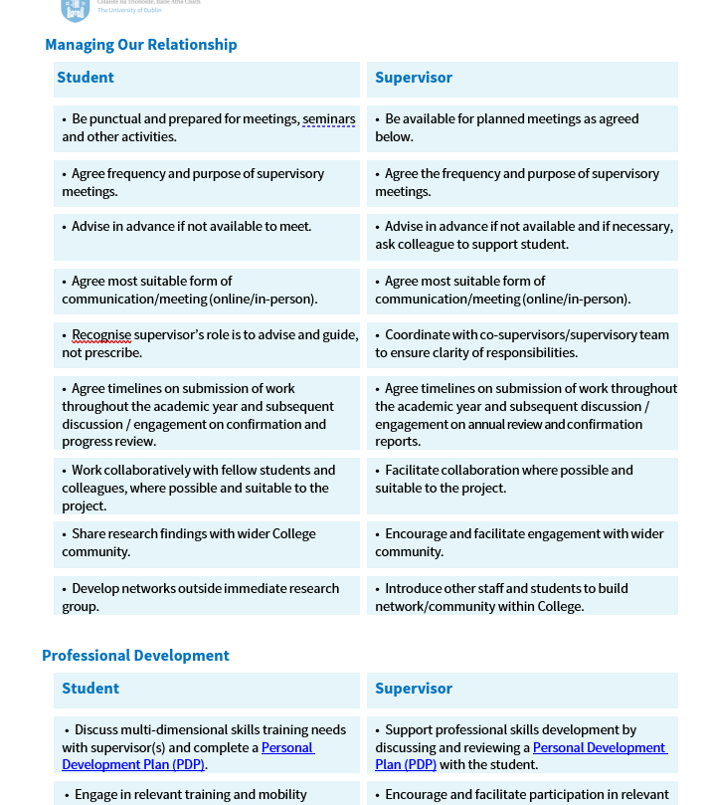
Be Proactive
Supervisor—Research Student Agreement – LINK TO PILOT
A menu of discussion points:
Academic Development,
Managing our Relationship,
Professional Development,
Supporting Wellbeing & Health.
An explicit statement of expectation
A tool for self-reflection on implicit expectations of themselves and the other party
Notes:
Martin: find out what is expected
take the initiative in raising problems or difficulties

Slide 13
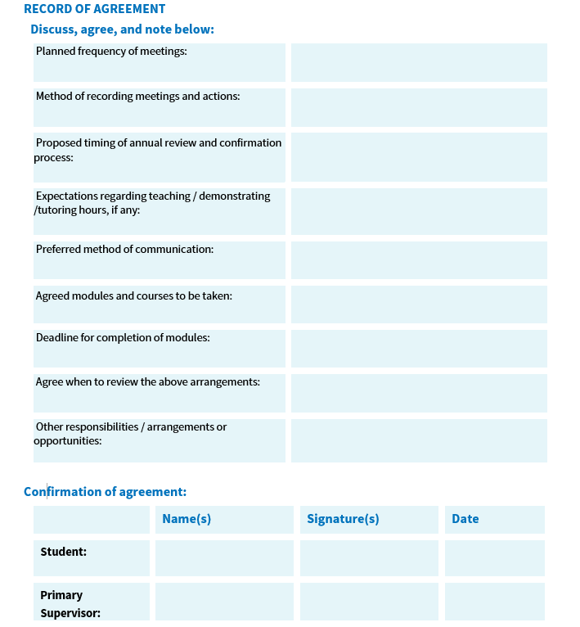
Be Proactive
Supervisor—Research Student Agreement – LINK TO PILOT
NOT:
  Legally-binding,
  Prescriptive,
  Box-ticking,
  A static document.
Set aside time for completion, ideally within first 8 weeks,
Identify elements that are relevant, and discuss and agree
Negotiate or add elements where needed
Review at least once per academic year
Notes:
Martin: find out what is expected
take the initiative in raising problems or difficulties

Slide 14
Know Your Supervisor
1
Before the first/ your next meeting find out:
Research Interests, Recent publications, Experience supervising
2
During the first/ your next meeting find out:
How much time they will have?
What kind of role does your supervisor expect to have?
3
After your next meeting decide:
What do you need to do to work within this paradigm?
Notes:
Martin: How to communicate
When busy?
Research interests
Know supervisor’s strengths/weaknesses
Isolation

Slide 15

Know Yourself
What are you good at?
What areas need improvement?
e.g. Communication style?
Organisation?
Training?
SWOT analysis
Notes:
Martin: SWOT analysis

Slide 16
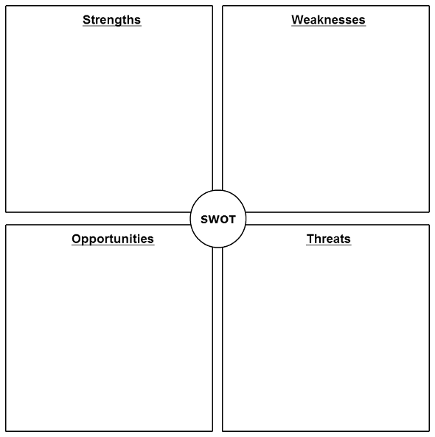
SWOT Analysis
I’m really organised,
I stick to an agenda very well.
I’m not good at asking for help,
I avoid difficult conversations.
Internal
(you)
They are too relaxed about deadlines- mine and theirs,
They will be away all of August
They are really supportive,
They always read my work.
External
(them)
Notes:
Nonie: talk through SWOT e.g. S (v. organised) | W (communication) | T (supervisor has busy schedule) | O (conferences abroad)
Take 1 minute to draw this yourself. Useful way to pre-empt issues

Slide 17

Empowered meetings checklist
Set the agenda beforehand
….ask if they have other topics they’d like to agree
Agree the date of next meeting at the meeting
….Put it in both diaries
Send a written recap
….Issues discussed, actions agreed, timelines for delivery
Always invite them to comment
Notes:
Martin

Slide 18
Sample Agenda and Meeting Notes
Date of Supervision meeting: | 1 June 2025
Agenda | Notes
Actions/ progress since last meeting
Work submitted for this meeting
Agreed tasks/ objectives for next meeting
Administrative matters (taking leave, deadlines, reviews/ reports)
Other comments
Date/ time of next meeting
Notes:
Martin

Slide 19

Communicate Professionally
Remember, this is YOUR degree: be assertive (but not rude!)
You can question/ disagree with your supervisor
Some academics avoid giving ‘harsh’ criticism, so be sure to ask “is there anything else you think I need to know/ do at this stage?”
Remember, some academics take good research/ writing for granted
Try not to be disheartened
Notes:
Martin

Slide 20
Things it's ok... and important... to ask:
Communicate Professionally
Clarify: "I want to make sure I understand you completely, can you repeat that last bit about X again?"
Expand: "Can you tell me a little more about what you mean when you say...X"
Disagree: "I'm not sure I agree with that, let me tell you why..."
Ask Additional Questions: "Is there anything else you think I need to know about the progress in general? Is there anything that I should have asked that I didn't?"
Next Meeting: "Thanks again for your time, can we schedule our next meeting now, while I'm here?"
Notes:
Nonie

Slide 21
Seek support early —you are not alone
Postgraduate Advisory Service – the frontline service postgrad.support@tcd.ie
Student’s Union
  Welfare and Education Officers
  Web: www.tcdsu.org
Student Counselling Service
    Web: tcd.ie/Student_Counselling
Student Learning Development
    Academic Writing Centre + 1:1 sessions
    Web: tcd.ie/student-learning.tcd.ie
Notes:
Nonie

Slide 22
So, for homework
Read the Research Student Handbook
Research your supervisor: publications, experience, etc
SWOT analysis:
    What am I good at?
    What do I need to work on?
    What can help me?
    What do I need to look for?
Further reading:
Rowena Murray, How to Write a Thesis, 2006
Notes:
Martin

Slide 23
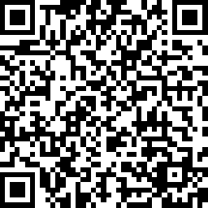
Give us feedback on this session, please!
Scan the QR code to fill in our 1-minute feedback survey
Responses are anonymous; no identifying information is requested.

Slide 24


Postgraduate Advisory Service
postgrad.support@tcd.ie
Visit the PAS website on tcd.ie
@TCDPGAdvisory
@TCDPGAdvisory
Notes:
24
Nonie

Slide 25
Thank You!

