Slide 1

Planning & Time Management PG Summer School 2024
Dr Grace Gaynor
student.learning@tcd.ie
http://student-learning.tcd.ie

Slide 2
Today’s Objectives
Explore planning/organisation needs and tools
Learn principles of goal setting and time management strategies
Learn ways and techniques to manage concentration and procrastination
Reflect on your own strategies and experiences

Slide 3

Planning

Slide 4
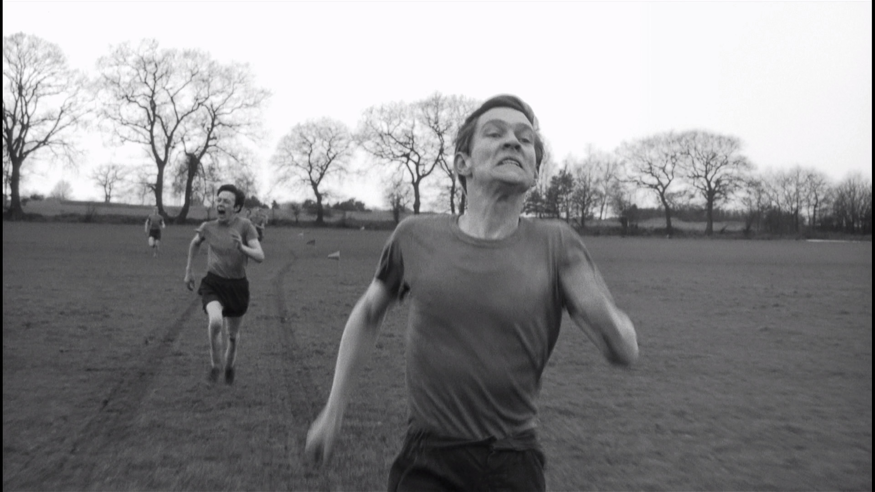

Slide 5
Self-Management Manage self and resources by:
Planning
Monitoring
Evaluating

Slide 6
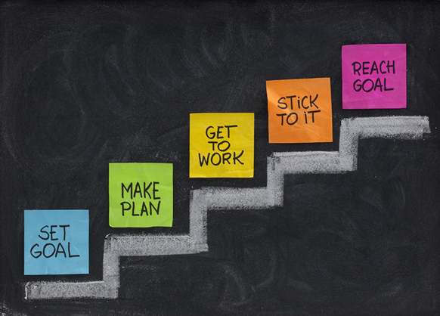
Planning - Goals
Project management
Milestones
Interim objectives
Deliverables

Slide 7

SMART Goals for Focus
Reward yourself when you complete goals
Specific
What do I want to do?
Measurable
How will I know when it’s done?
Achievable
Is it a reasonable goal?
Relevant
Is the goal related to work?
Timely
Does the goal have a time-limit?

Slide 8
SMART Goals
S = Specific
SMART is a useful framework for goal setting, particularly for short-term goals like study goals or tasks.
Specific, measurable and realistic goals tend to lead to better effort and persistence.
SMART goals lead to outputs which make you feel productive.
When setting goals:
Write the goal down. We are more likely to do things we write down (as opposed to saying/thinking).
Make a commitment, I WILL not I’LL TRY.
Make goals positive, reframe if it’s worded negatively.
Increase motivation
Keep you on track (feedback)
Increase Productivity
M = Measurable
A = Action-related
R = Realistic
T = Time-based
Make it SMART: ‘Write a chapter’
Notes:
Again borrowing from project management and strategic planning. Identified what your goals might be, but when we’re thinking about how to set these goals, think SMART. Ask for feedback from inside room and online. Example ‘Write 5,000 words for Methods chapter and send it to my supervisor by 25 March.’

Slide 9
Planning
1. Master plan to guide you overall
2. Minor plan to guide you day-to-day and week-to-week

Slide 10
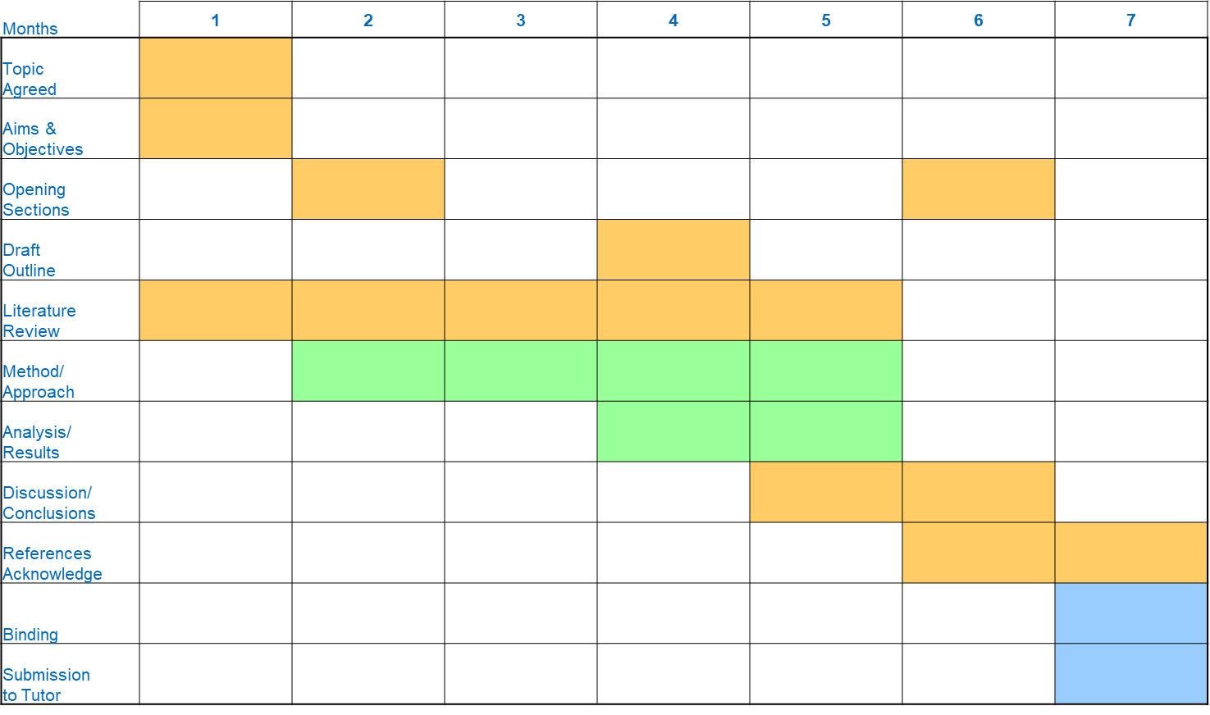
Gannt chart

Slide 11
Possible Timeline
Submission Date ___________________
Proposed draft deadlines:
 | Draft 1 | Draft 2 | Final Revision
Ch. 1 - Introduction
Ch. 2 - Literature Review
Ch. 3 - Methods
Ch. 4 - Findings Interviews
Ch. 5 - Findings Document/Inventory
Ch. 6 - Discussion
Ch. 7 - Conclusion
Abstract

Slide 12
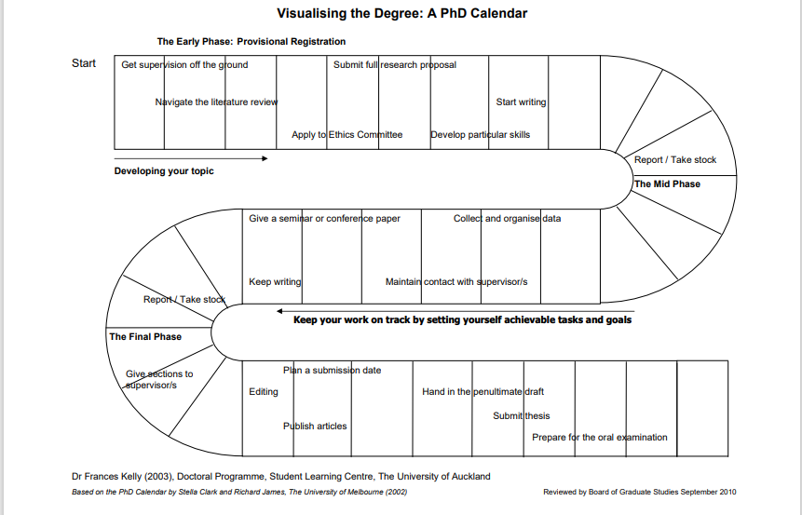

Slide 13

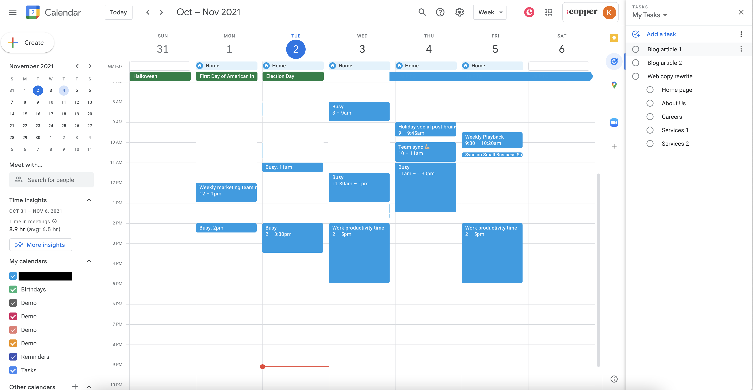
Minor plan
Self-management
Realistic
Staying motivated
Marathon – steady
SMART

Slide 14
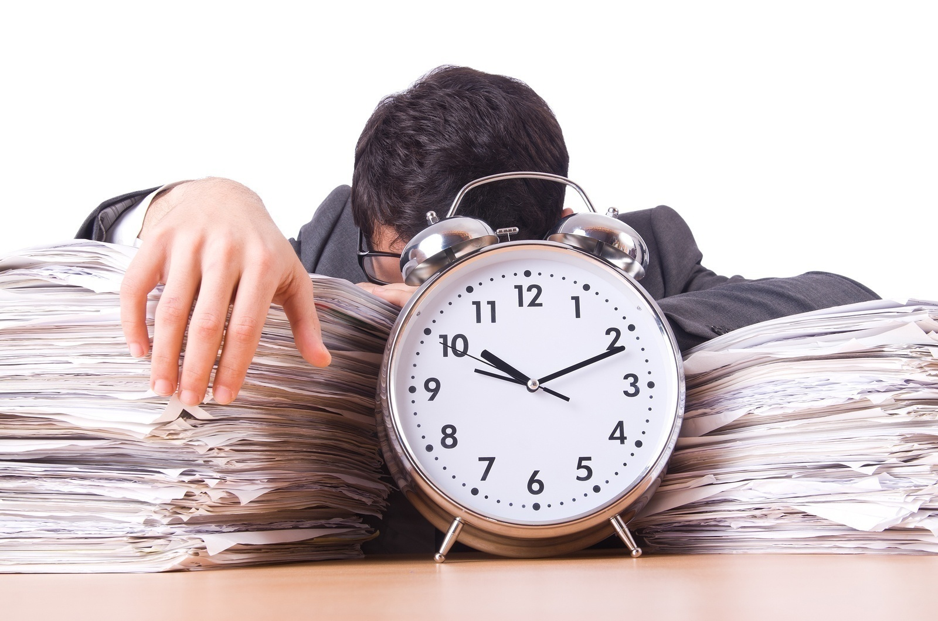
Time Management

Slide 15
Time Management Strategies
Implementing study (and other!) goals
What works for you?
Prioritise
Time blocking
Deadlines – soft and hard
Space/environment
Routine
Say no

Slide 16
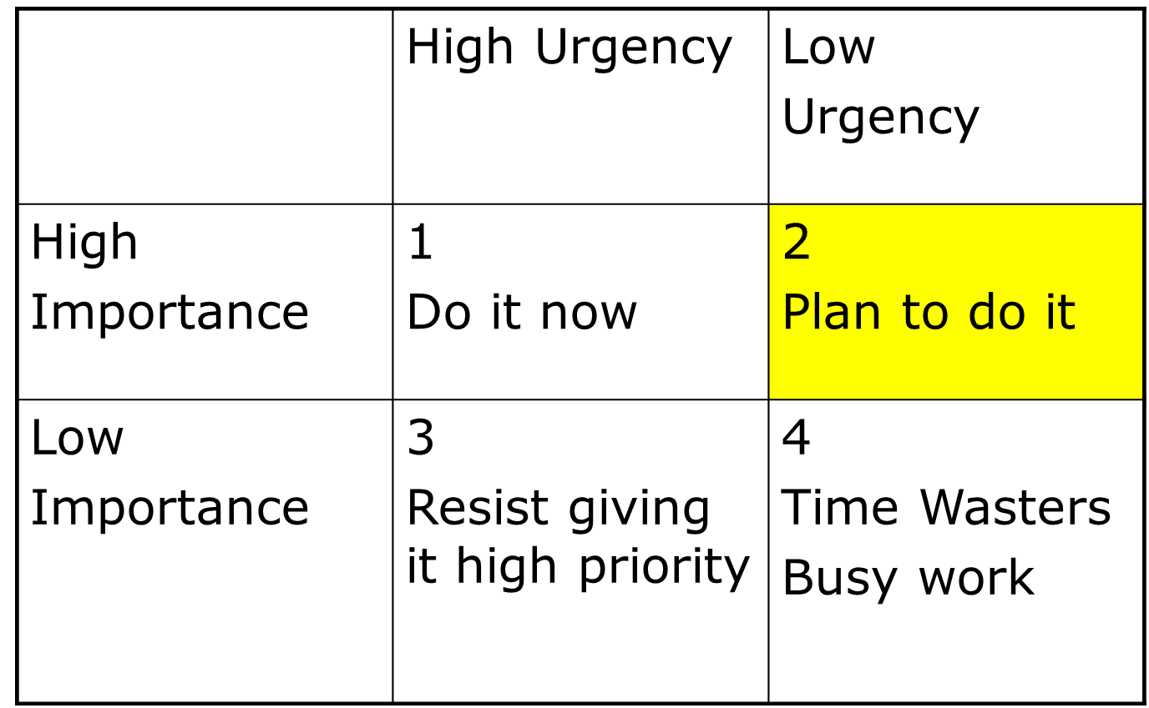
Setting Priorities

Slide 17
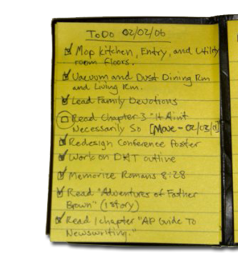
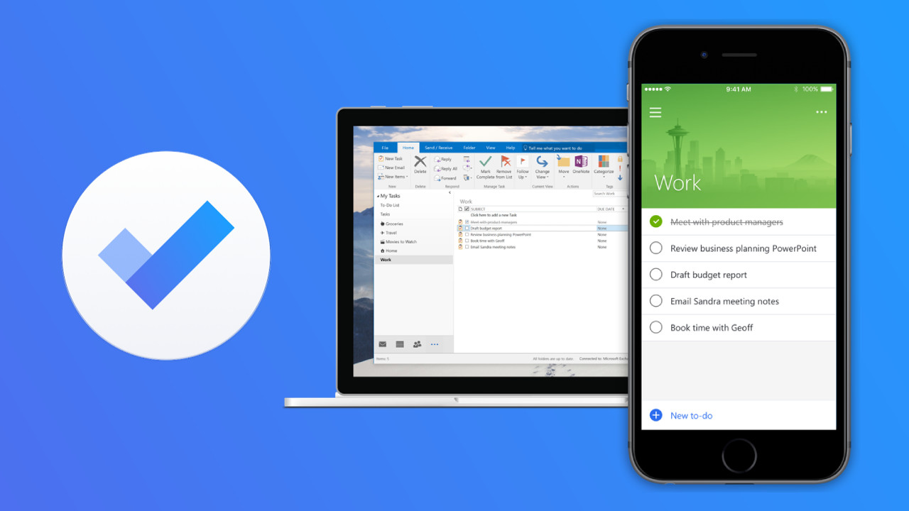
To-do list
Make a list of all tasks
3 Ds:
Done in 2 mins - do it now
Diary/to-do list
Dump it!
Remember - Prioritise

Slide 18
Time Blocking for Minor Plans
Plan all tasks for the week
Define blocks of time and allocate tasks
Use all available time: small time and ’dead’ time
Revise as needed
Further information -
https://www.calnewport.com/blog/2013/12/21/deep-habits-the-importance-of-planning-every-minute-of-your-work-day/
https://todoist.com/productivity-methods/time-blocking

Slide 19
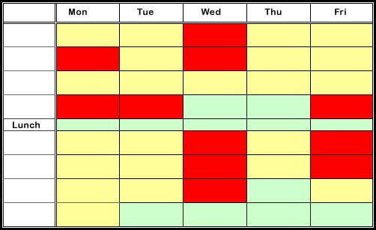
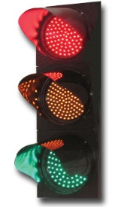
Time-blocking Timetable
Complete the timetable using different patterns or colours:
E.g. use Red for example to indicate lecture times, tutorials, etc. Use Yellow for time you plan to study and Green for your social and relaxing time
Working efficiently means you knowing when to take breaks and requires that you also plan time for fun and relaxation

Slide 20
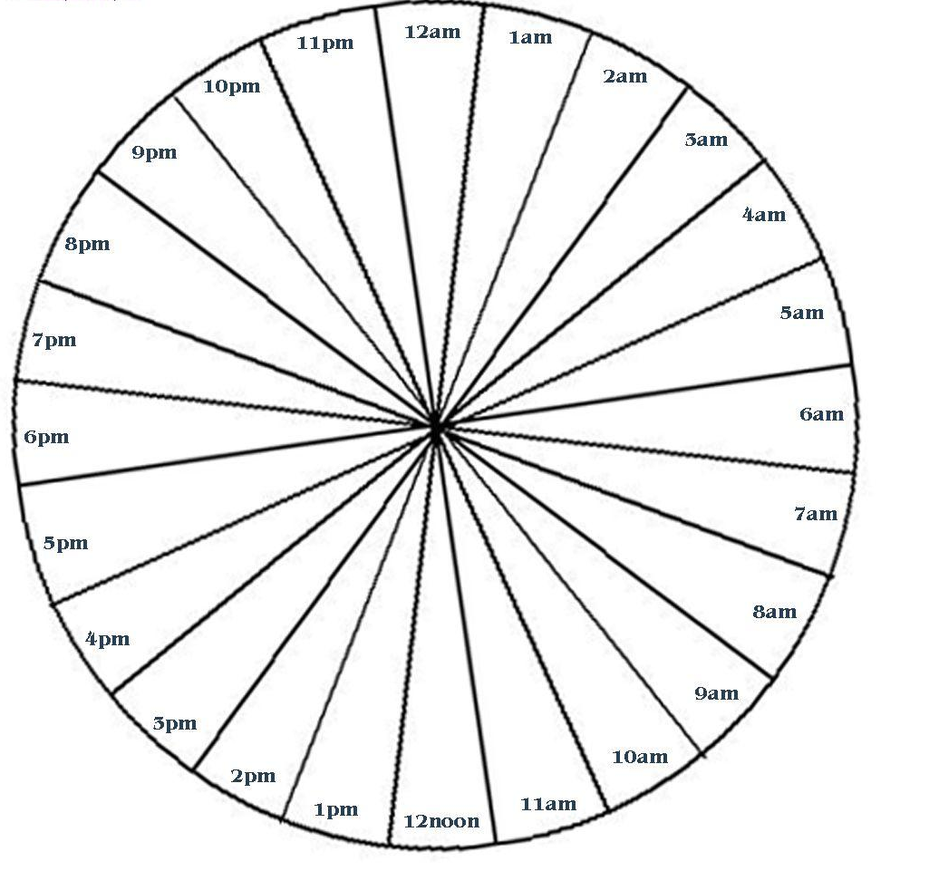
Time circle – 1 day
How I use time now
How I want to use my time

Slide 21
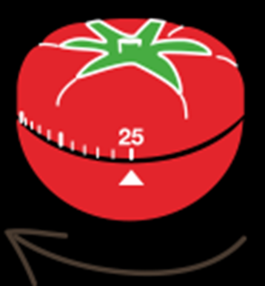
Pomodoro technique
Time blocking system
25 minutes = a pomodoro, 5 minute break
4 pomodoros, long break
https://francescocirillo.com/pages/pomodoro-technique
https://tomato-timer.com/

Slide 22

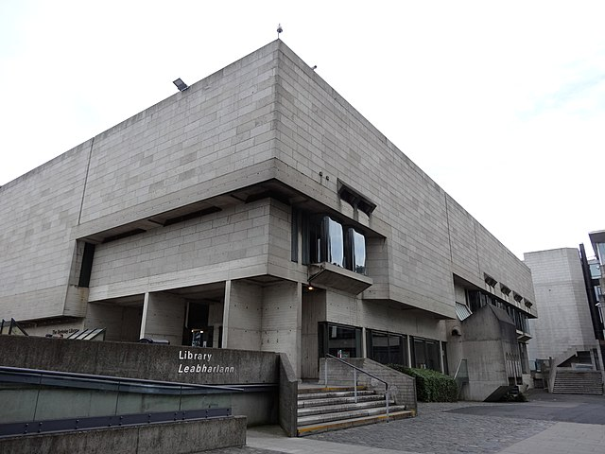
Space/Environment
Where do you work best?
Place suitable to task
Break your day into different tasks & spaces
Keep distractions (e.g. phone, social media) out of sight
Clear away clutter
Large container if moving rooms

Slide 23

What are your distractions or time-stealers?
How do you deal with them?

Slide 24
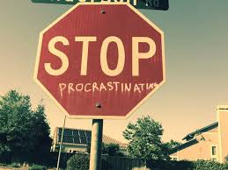
Why?
Taking action

Slide 25
Tools for blocking websites/apps
Selfcontrolapp.com – use with macs, free
Freedom - Block Websites, Apps, and the Internet
FocusWriter (gottcode.org) – mac & pc; for writing
Stay Focused – Google extension, restricts time on websites
LeechBlock – as above but for Firefox
Focusboosteapp.com – pomodoro & time tracker
Cold Turkey - The Toughest Website Blocker on the Internet (getcoldturkey.com)
www.forestapp.cc - stay focused plant a tree
More at: https://wallstreetinsanity.com/10-apps-that-block-distractions/

Slide 26

Organisation

Slide 27
Organisational needs to consider
Use a reference management system (e.g. EndNote, Mendeley, Zotero)
Way to manage your notes/note taking (e.g. Evernote or Scrivener)
Storage and Backup
System for organising your research data
Find a way to remember everything you do (a diary on personal task manager ‘Omnifocus’).

Slide 28

Organise your mind
Positive attitude
Positive language
Self-efficacy
Goals and wants

Slide 29

Questions?

